Slide 1
DTMF based Electronic voting system
Minor Project-
By Vallabh walse

Slide 2
Introduction
India is world’s largest democracy. Fundamental right to vote or simply voting in elections forms the basis of Indian democracy. In India all earlier elections a voter used to cast his vote by using ballot paper. This is a long, time-consuming process and very much prone to errors.
This situation continued till election scene was completely changed by electronic voting machine. No more ballot paper, ballot boxes, stamping, etc. all this condensed into a simple box called ballot unit of the electronic voting machine.

Slide 3
Components
DTMF Module MT8870D
LCD matrix display(16*2)
Arduino Uno R3 microcontroller

Slide 4
DTMF module
DTMF (dual tone multi frequency) is the signal to the phone company that you generate when you press an ordinary telephone's touch keys. In the United States and perhaps elsewhere, it's known as "Touchtone" phone (formerly a registered trademark of AT&T). DTMF has generally replaced loop disconnect ("pulse") dialling. With DTMF, each key you press on your phone generates two tones of specific frequencies. So that a voice can't imitate the tones, one tone is generated from a high-frequency group of tones and the other from a low frequency group. Here are the signals you send when you press your Touchtone phone keys:

Slide 5
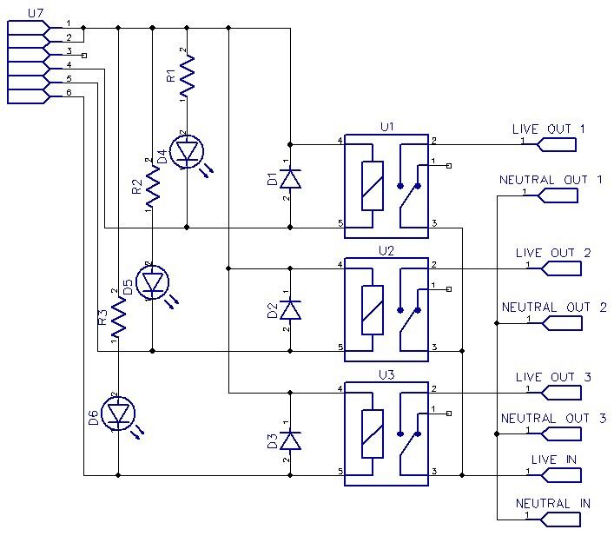

Slide 6
advantages
Cell phone based voting machine is capable of saving considerable printing stationery and transport of large volumes of electoral material.
It is easy to transport, store, and maintain. It completely rules out the chance of invalid votes.
Ease of handling.
Boon for physically challenged people.

Slide 7
Disadvantages
At this stage, it’s hackable and under process.
The phone we are using should be kept protected.

Slide 8
Thank you!

